Slide 1
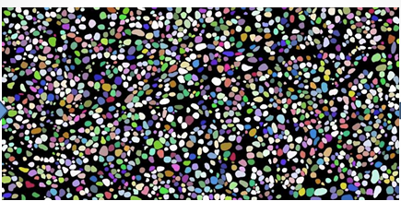
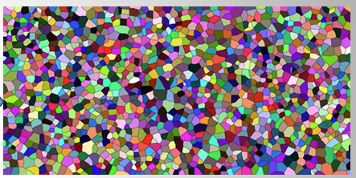
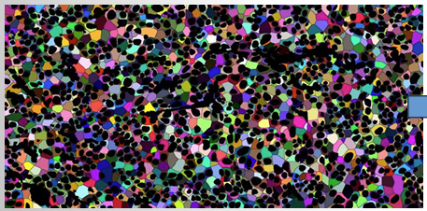
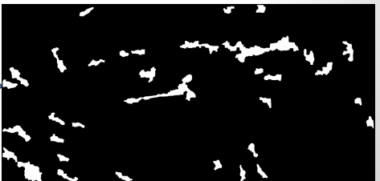
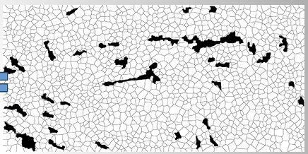
 | Mask to save
1 | DAPI/nucleus mask
2 | Voronoi mask
3 | Stroma mask
3 | Voronoi with stroma subtraction
4 | Cytoplasm mas (Voronoi after nucleus and stroma subtraction)
5 | DAPI/nucleus mask w/ stroma subtraction
DAPI
Voronoi
Cell membrane
Voronoi with stroma subtraction and nucleus subtraction
Stroma mask
Voronoi/Cell mask

Slide 2
Why do we quantify MenaINV in stoma only?
We exclude stroma because we want to assess MenaINV intensity in tumor cells only and the fibroblasts in stroma can express quite a lot of MenaINV.

